Slide 1

DELANO BAY CHRISTIAN CAMP
Granberg Lodge Recovery Plan
Presented by DBCC Board

Slide 2
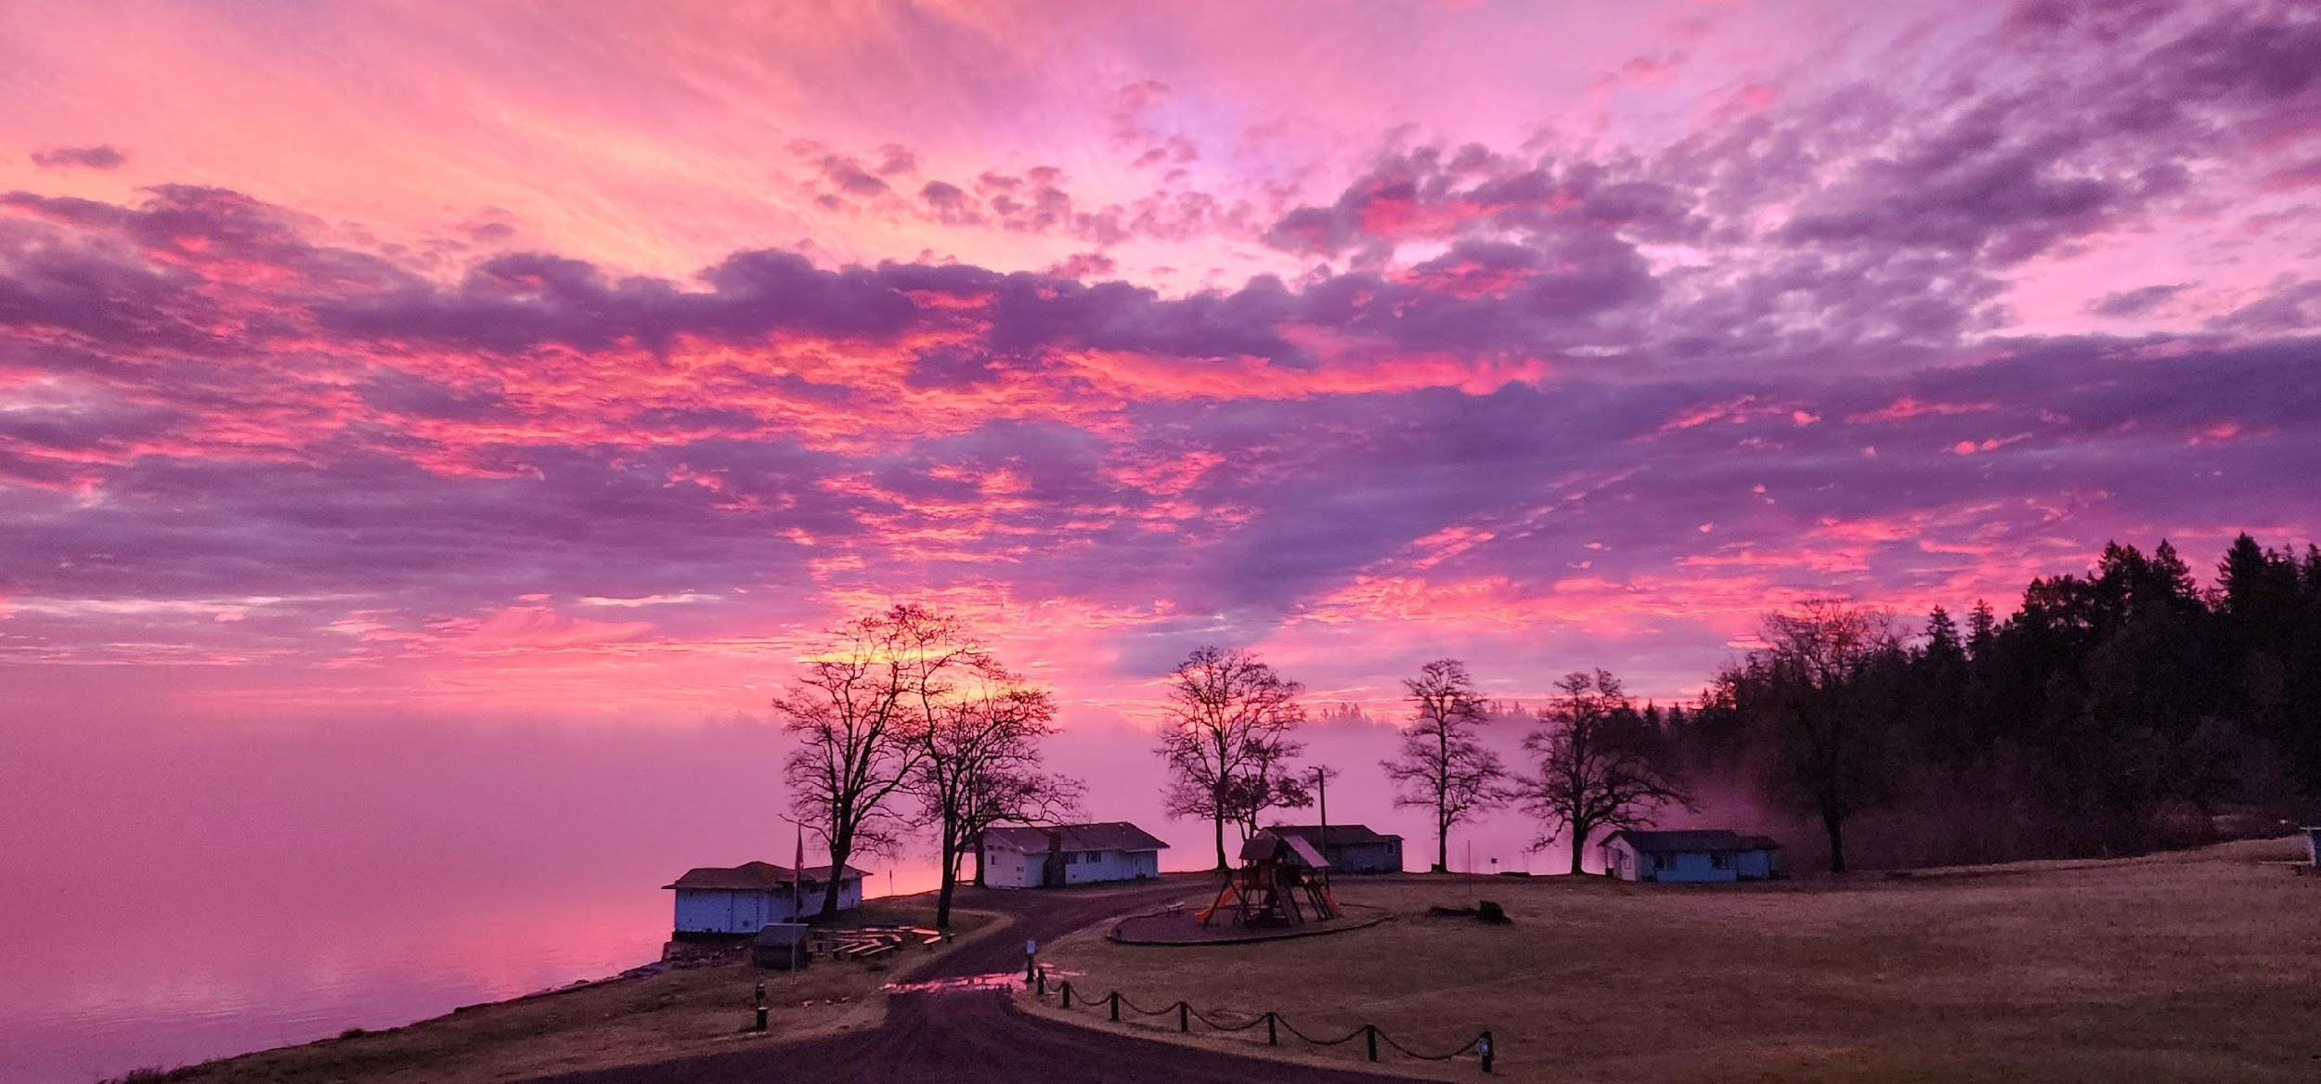

02
Today's Discussion
TOPICS TO BE COVERED
What Happened
Why it Happened
What the Board is Doing to Rectify
The Two-Phase Restoration Plan
Lessons Learned & Renewed Oversight
Goals
Call to Action
DBCC | Granberg Lodge Recovery Plan

Slide 3

THE GRANBERG LODGE
03
Restoring the Heart of Delano Bay Christian Camp
“Unless the Lord builds the house, the builders labor in vain.” – Psalm 127:1
DBCC | Granberg Lodge Recovery Plan

Slide 4
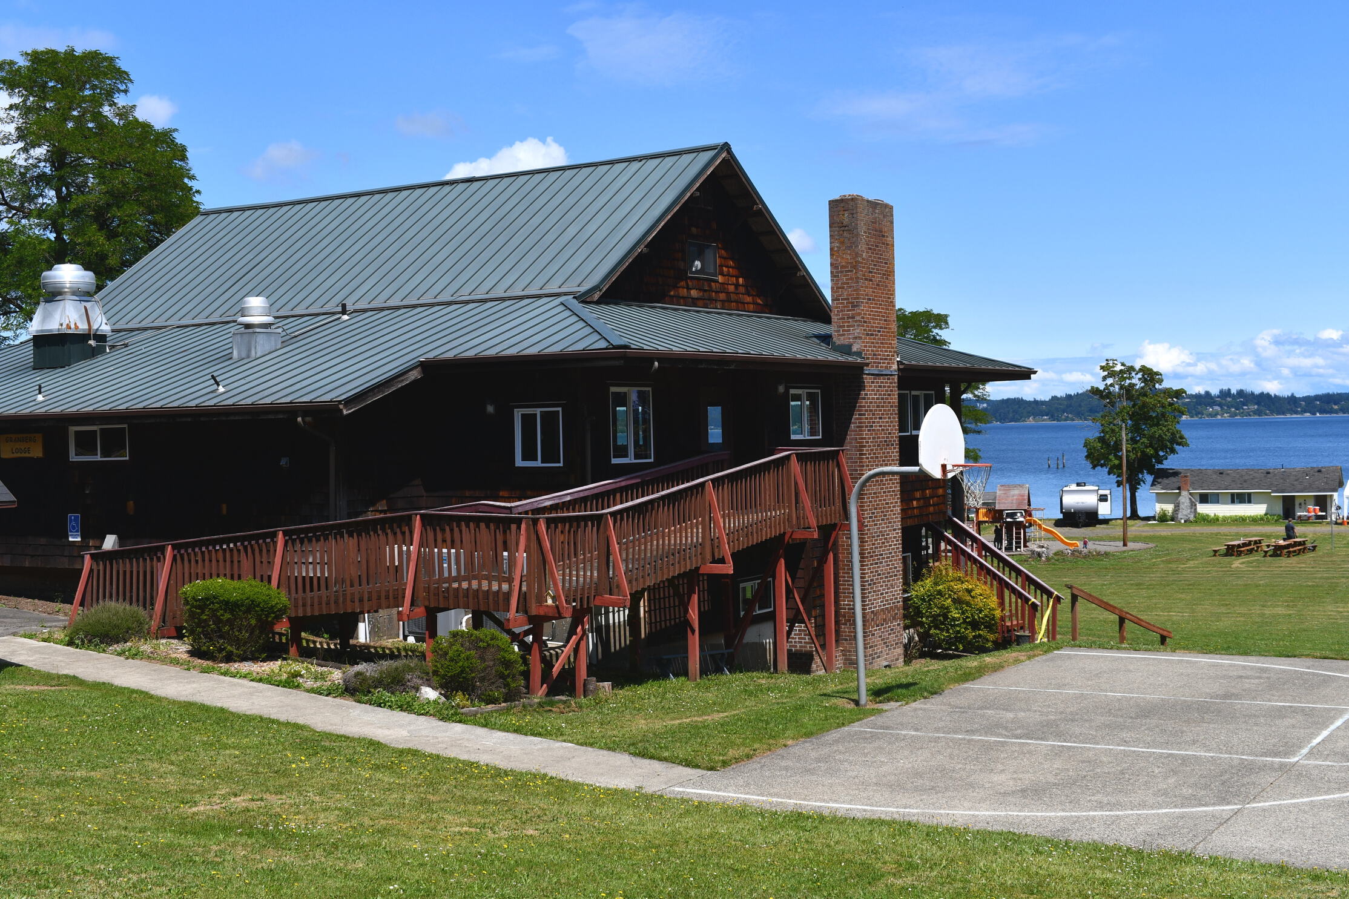
05
What Happened?
AN INTRODUCTION
  October 2021: Severe water damage caused by intentional flooding of the Lodge.
  Both levels flooded, rendering the Lodge unusable.
  The Lodge — once the hub for meals and fellowship — has been closed since.
“When you pass through the waters, I will be with you.” – Isaiah 43:2
DBCC | Granberg Lodge Recovery Plan

Slide 5
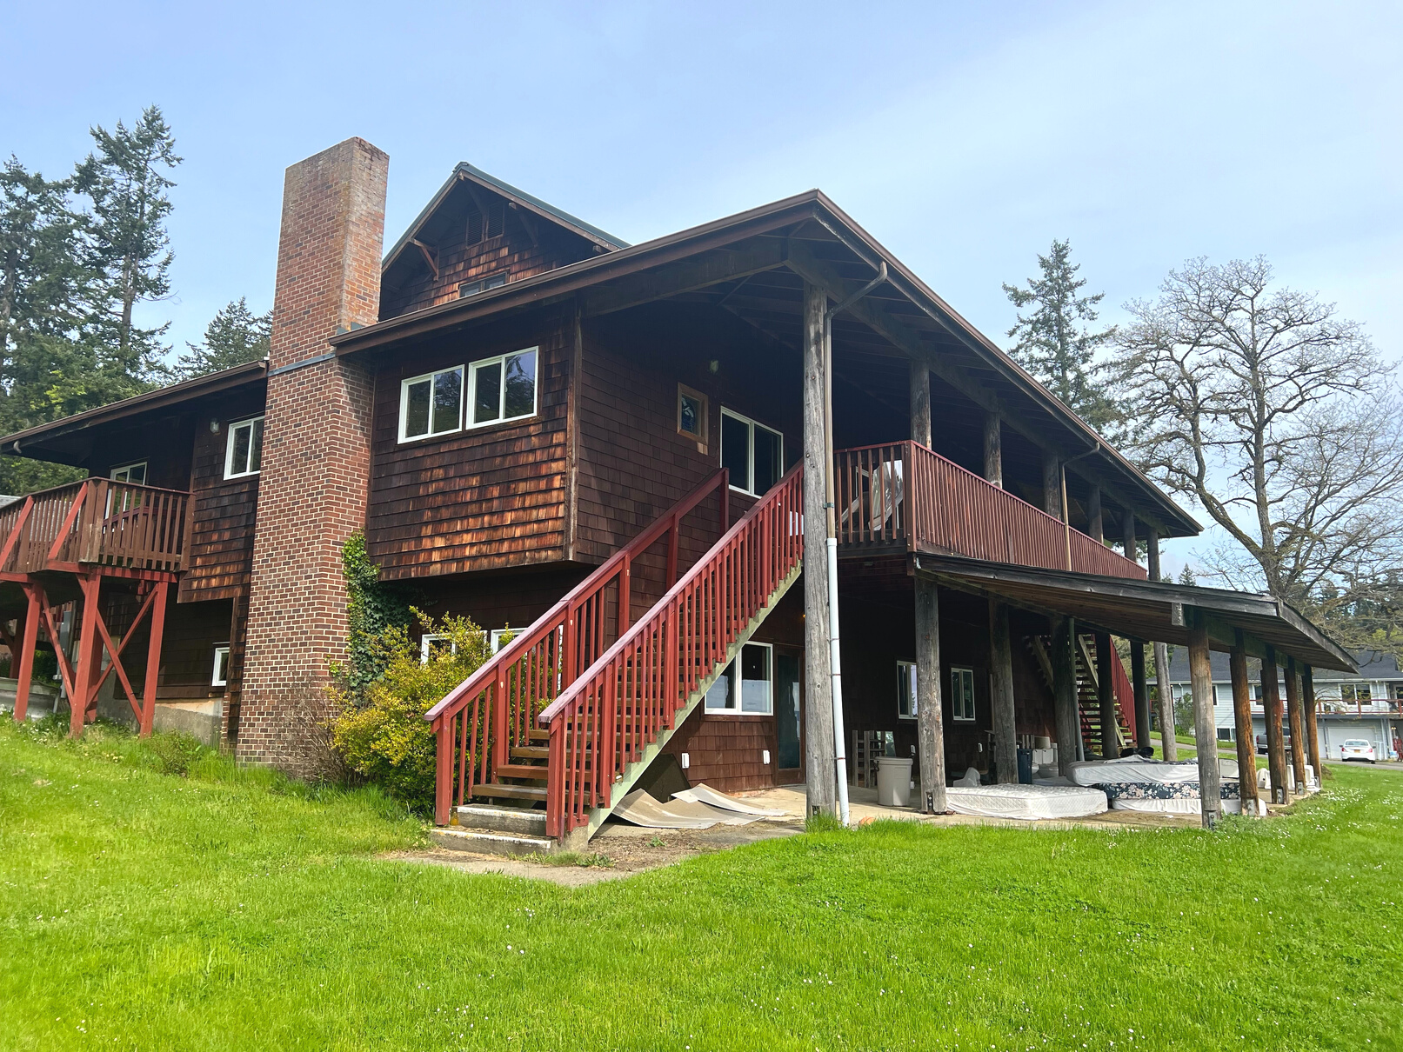
Why It Happened
05
“THE PRUDENT SEE DANGER AND TAKE REFUGE, BUT THE SIMPLE KEEP GOING AND PAY THE PENALTY.” – PROVERBS 27:12
  Initial contractors were hired quickly without thorough vetting.
  Insurance and adjuster changes complicated progress.
  Delays with permits and county prioritization slowed recovery.
DBCC | Granberg Lodge Recovery Plan

Slide 6
Timeline of Events
06
WHAT WE'VE DONE IN THE PAST
2021
2022
2023
2024
The Lodge at Delano Bay was identified as needing major restoration, and the board began planning the scope of work.
A contractor was engaged to handle the Lodge repairs, but progress was slow and communication issues began to surface.
Despite expectations of work beginning, caretakers confirmed by December that no meaningful restoration had taken place.
After continued delays, mismanagement, and lack of progress, Delano Bay officially terminated its contract with Athens in September.

Slide 7
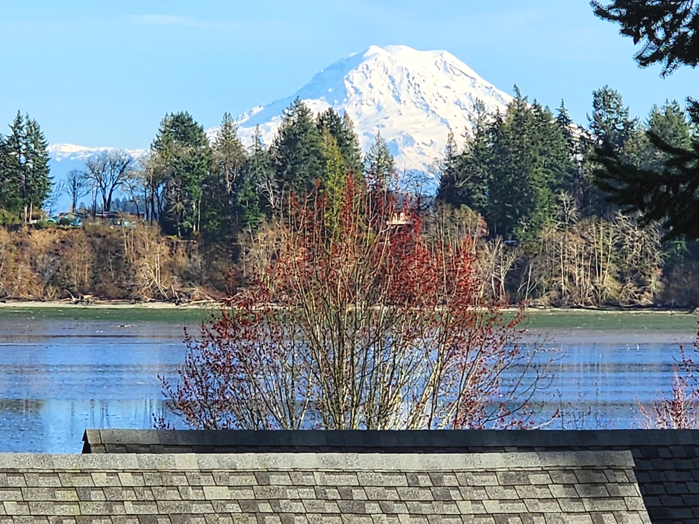
07
What the Board is Doing to Rectify
  Added Rick Bell as Project Manager & Board Member with construction experience
  Greater diligence in contractor selection.
  Transparent communication through newsletters, FAQs, and updates.
  Stronger oversight and stewardship of funds.
“Now it is required that those who have been given a trust must prove faithful.” – 1 Corinthians 4:2
DBCC | Granberg Lodge Recovery Plan

Slide 8
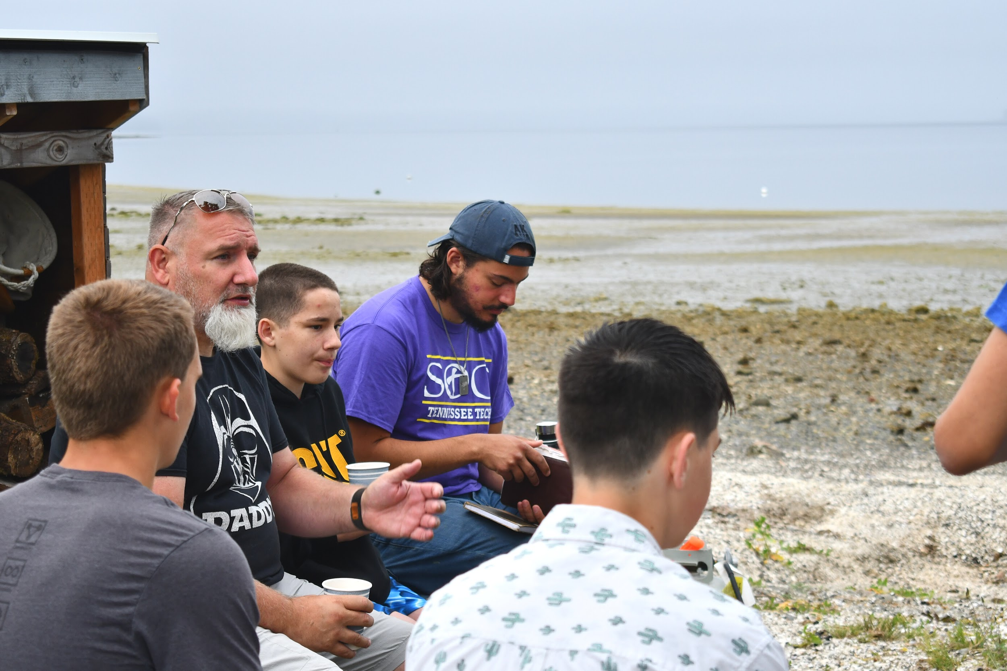
The Two-Phase Restoration Plan
08
  Phase 1 (2025): Restore and reopen the upper level (less damage)
  Phase 2 (2026): Complete lower-level reconstruction and mechanicals
“The plans of the diligent lead to profit.” – Proverbs 21:5
DBCC | Granberg Lodge Recovery Plan

Slide 9
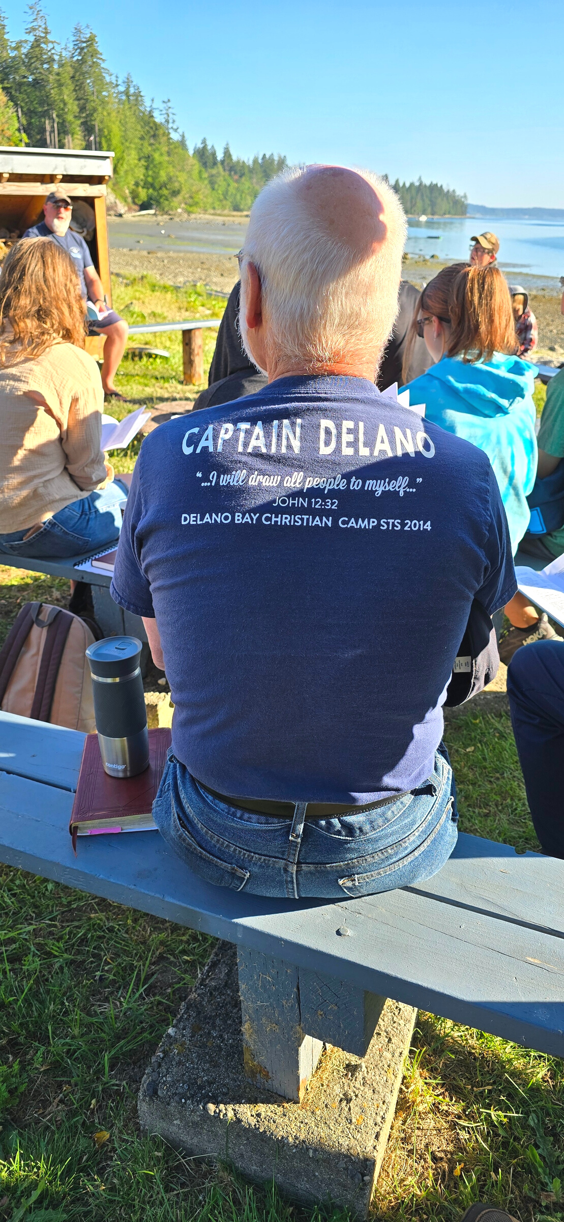
09
Lessons Learned & Renewed Oversight
  Implementing multiple bids and contractor vetting for transparency
  Strict payment disbursement tied to progress milestones.
  Ongoing financial reporting and transparency to stakeholders.
  Ongoing updates through newsletters, FAQs, and social media
  Board oversight strengthened with construction and financial expertise.
“But everything should be done in a fitting and orderly way.”
– 1 Corinthians 14:40
DBCC | Granberg Lodge Recovery Plan

Slide 10
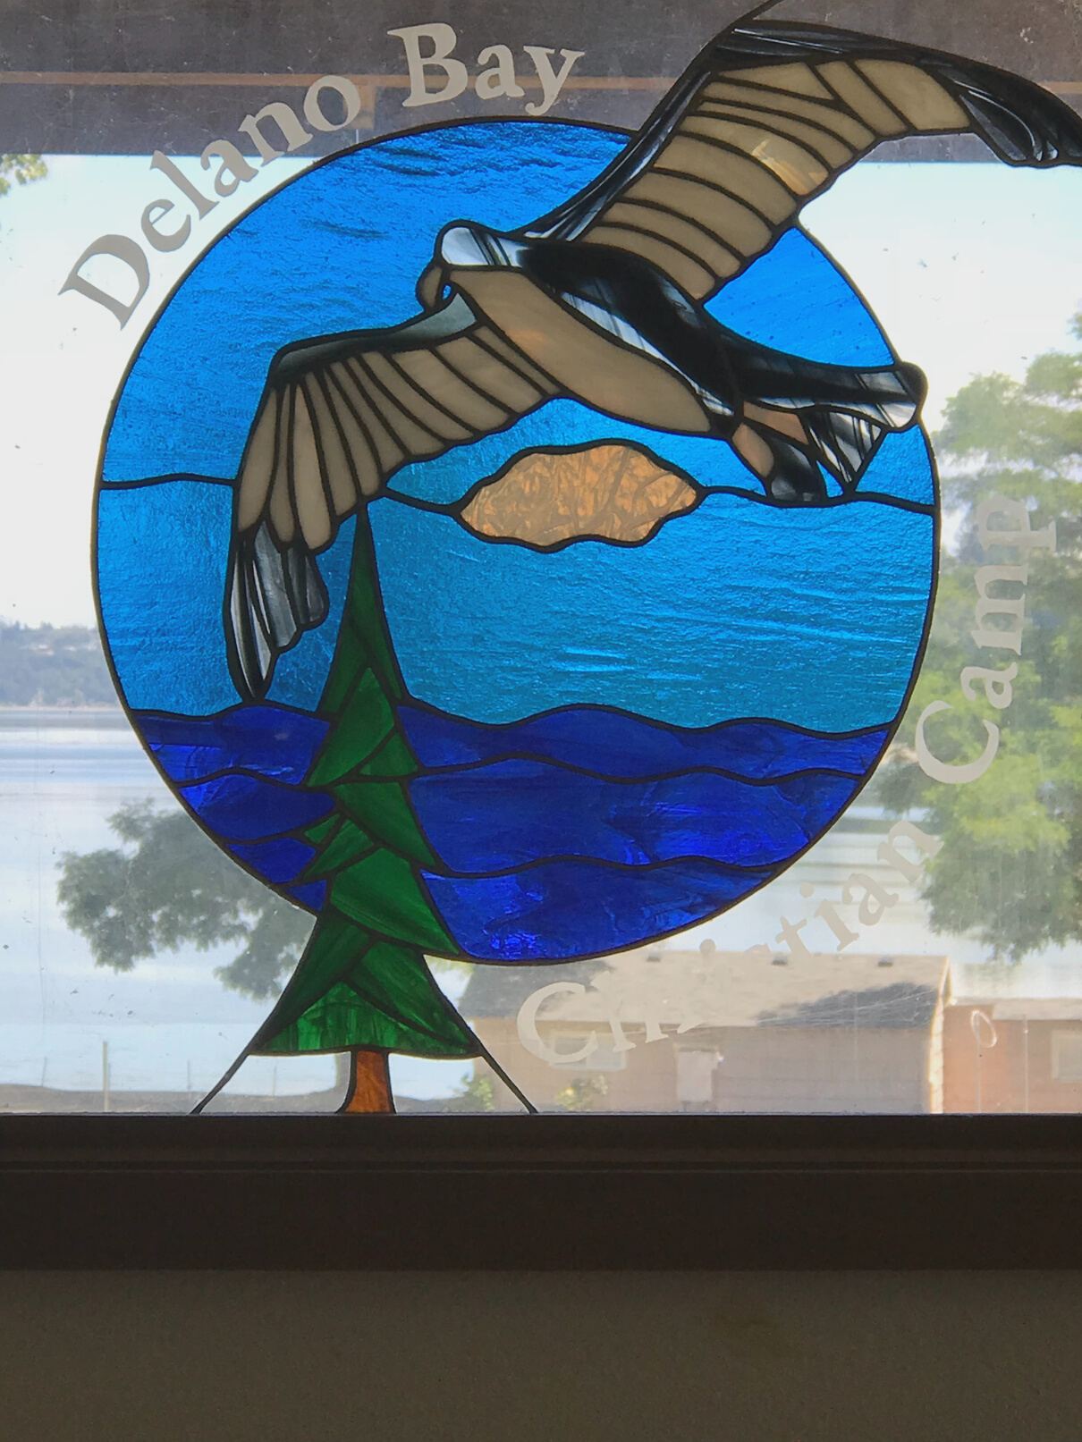
Goals
10
  Total Goal: $400,000
    $300,000 by January 2026
    $400,000 by March 2026
      Partner Churches – $150,000
        Five or more churches pledging or raising $30,000 each
          → $150,000 toward the foundation of the project
      Individual Donors – $200,000
        20–30 high-capacity donors giving through pledges and events
          → Includes the 2025 Donor Gala and personal appeals
      Local Businesses – $50,000
        Sponsorship tiers ranging from $500–$5,000
          → Cash, materials, and in-kind support from the local community
Together we will reach $400,000 — restoring the Lodge for meals, fellowship, and worship once again.
“Each of you should use whatever gift you have received to serve others.”
— 1 Peter 4:10
DBCC | Granberg Lodge Recovery Plan

Slide 11
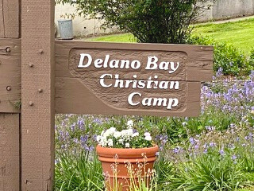
Call to Action
11
  How churches can help:
    Host a Delano Bay Sunday or special offering service
    Join a Sponsorship Tier (Gold: $10,000 – name a lodge room)
    Attend or host Fall 2025 Regional Gathering
    Encourage congregants to pledge or give online
    Pray for wisdom and provision.
    Give generously — as individuals and congregations.
    Share updates with your members.
““Each of you should use whatever gift you have received to serve others, as faithful stewards of God’s grace.” – 1 Peter 4:10
DBCC | Granberg Lodge Recovery Plan

Slide 12
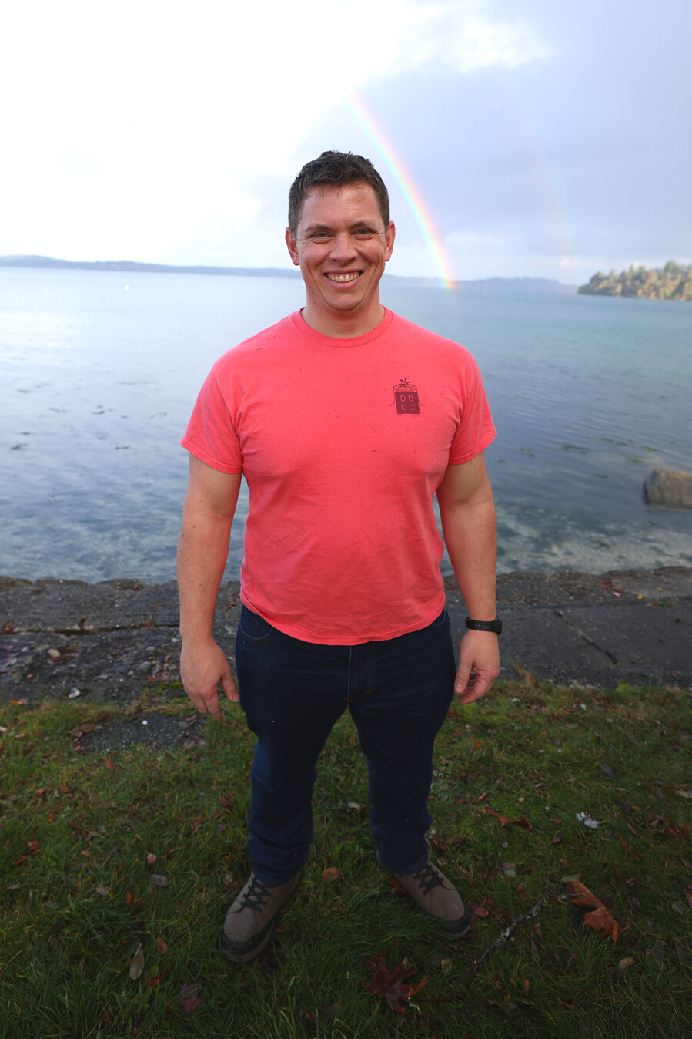
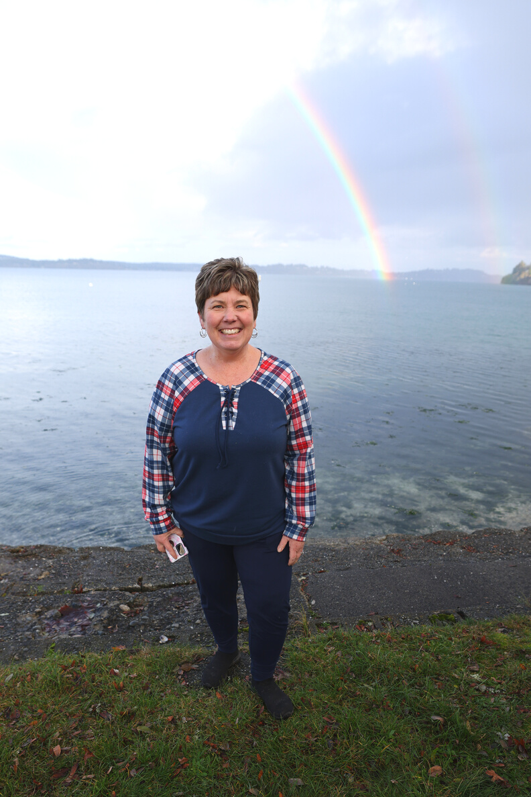
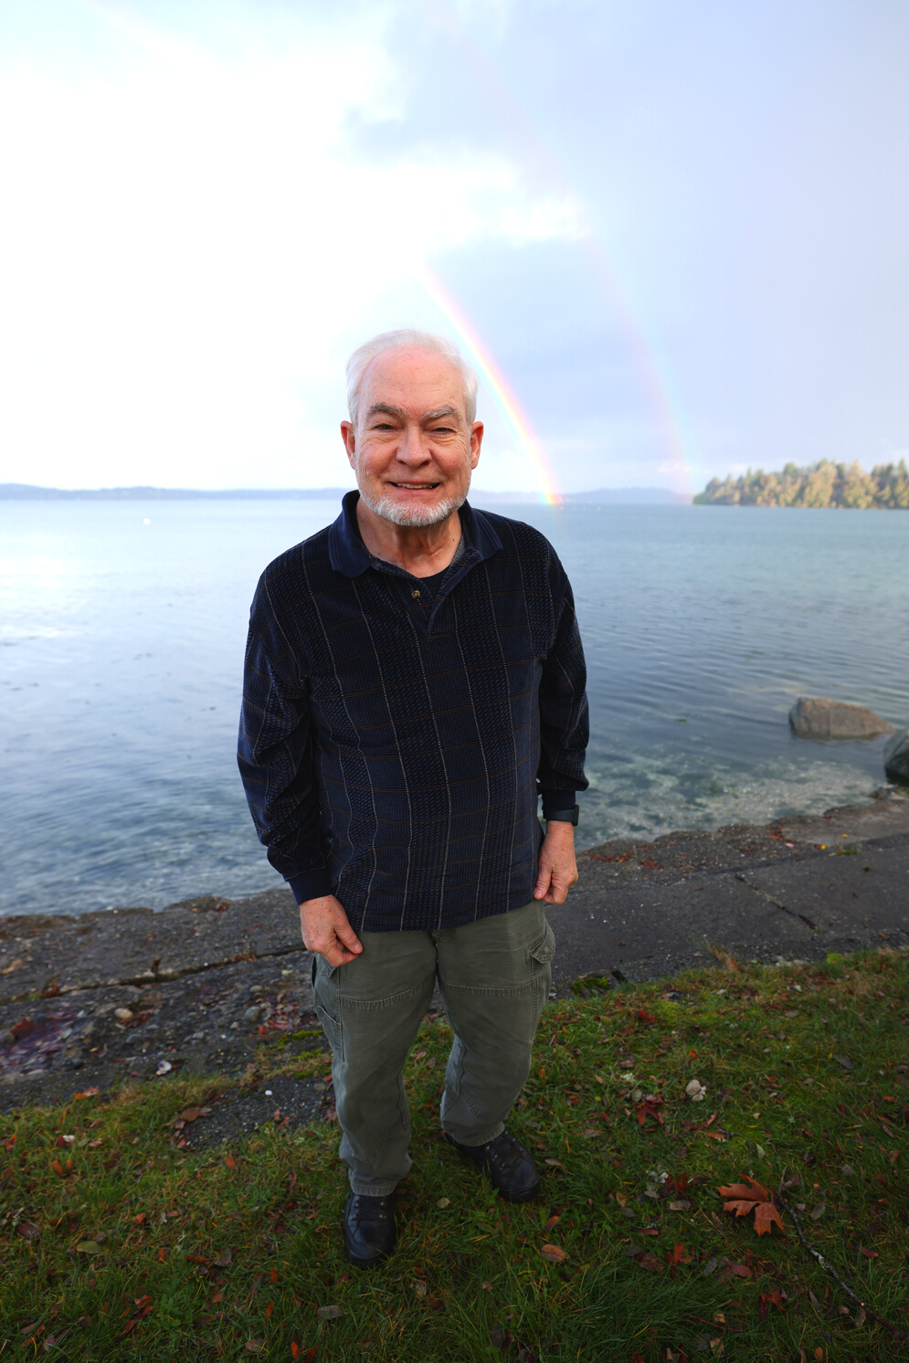
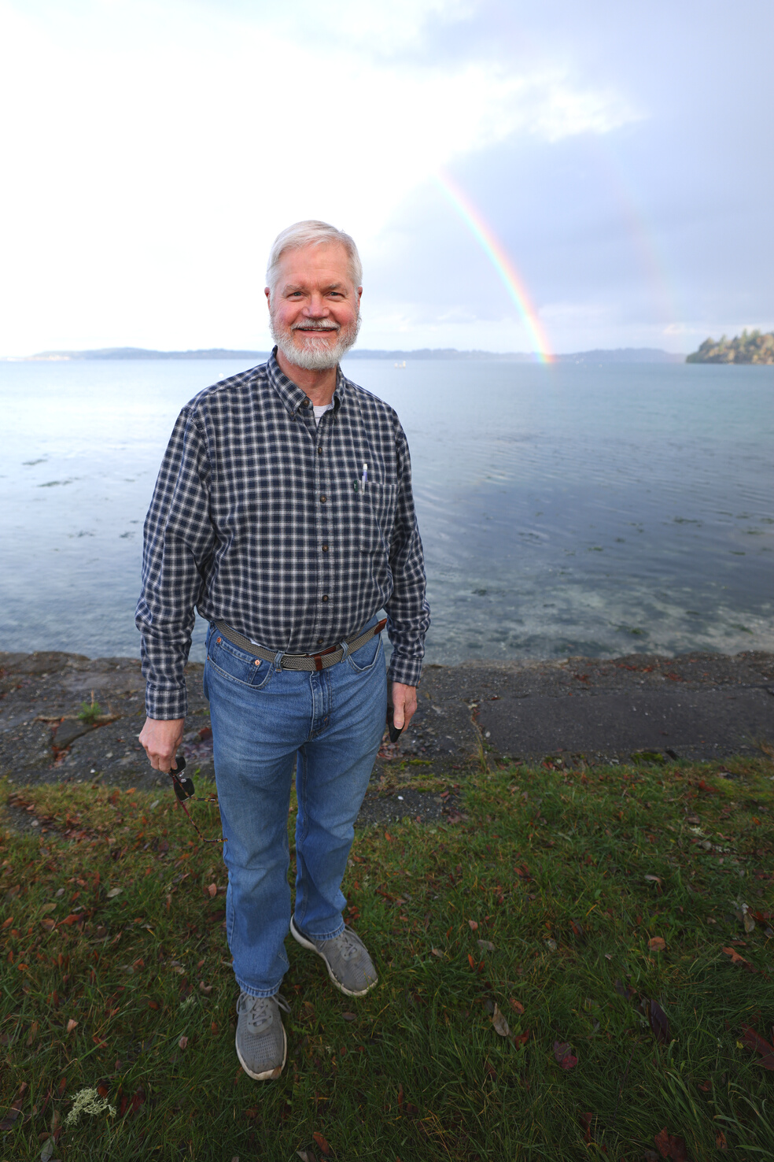
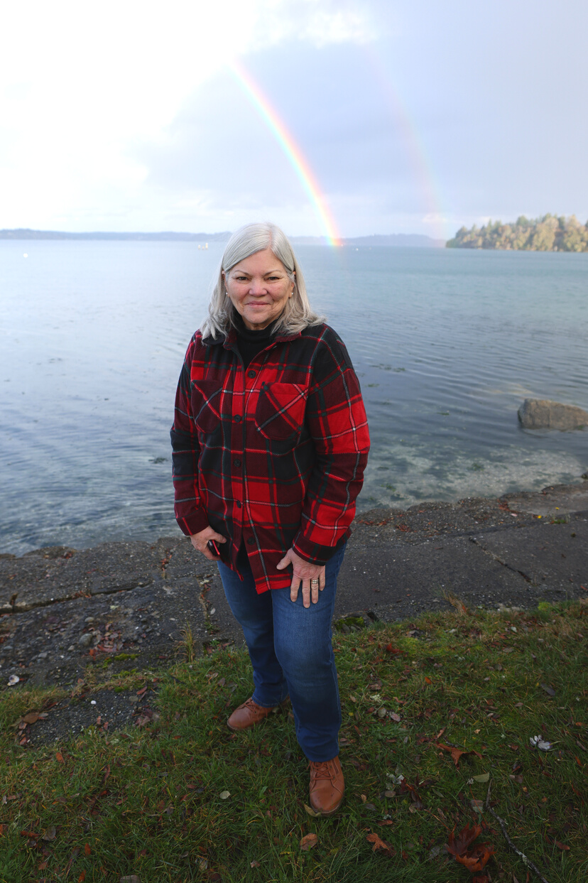
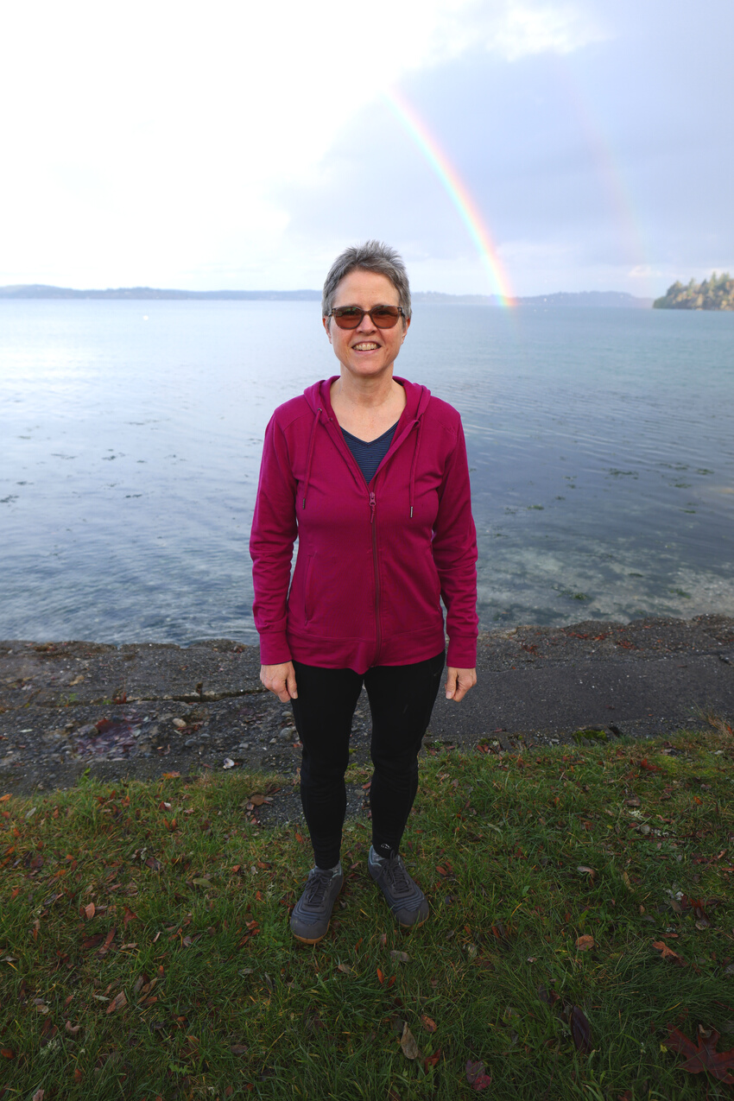
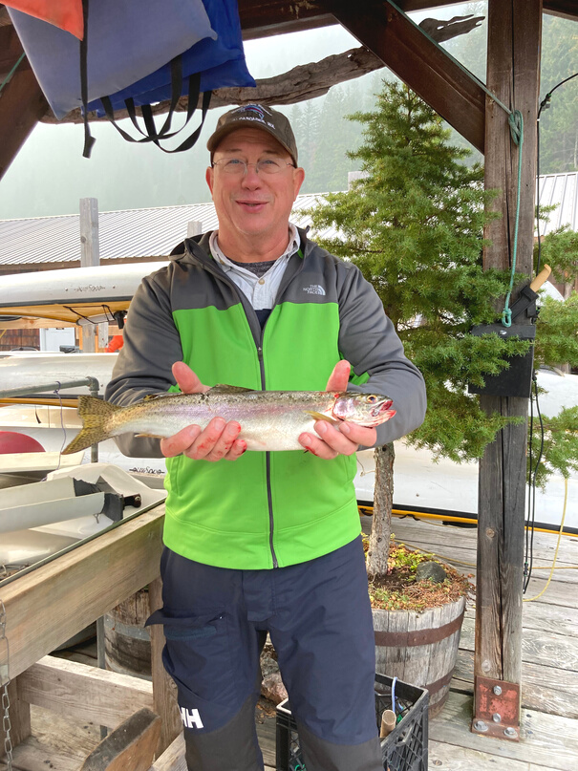
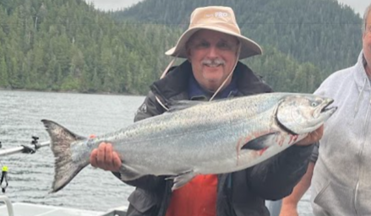
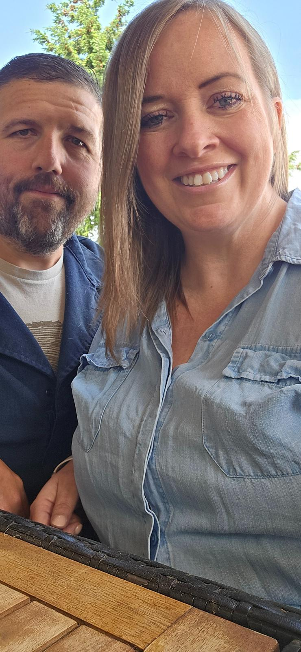
The DBCC Board
12
MAKING OUR FUNDRAISERS POSSIBLE
Thomas Morse
Cindy Oden
Don Mellor
Gene McCaul
Paula Davis
Chairman - Springbrook
Vice Chairman - Puyallup
Treasurer- Lakeview
Secretary-Puyallup
Member- Lakeview
Lisa Bratcher
Mike Anglada
Rick Bell
Member - Port Orchard
Member - Central Kitsap
Project Manager/Member - Port Orchard
The DBCC Caretakers
Jess and Theresa Aldred
KEEPING OUR CAMP RUNNING
Central Kitsap

Slide 13

Contact Us
13
Address
810 Stamford Road SW, Lakebay WA 98349
Phone
(253) 884 - 2966
Email
info@delanobay.org
DBCC | Granberg Lodge Recovery Plan

